Slide 1

ELV SYSTEMS AND DEVICES
ELV PRODUCTS

Slide 2













ELV PRODUCTS
PRODUCT/SYSTEM | BRAND
CENTRAL BATTERY EMERGENCY& EXIT LIGHTING SYSTEM (DCD CERTIFIED)
LIGHTING CONTROL AND HOME AUTOMATION SYSTEM
MOTION DETECTORS & LIGHT FITTINGS
BUILDING MANAGEMENT SYSTEM
GUEST ROOM MANAGEMENT SOLUTION
FIRE ALARM SYSTEMS

Slide 3
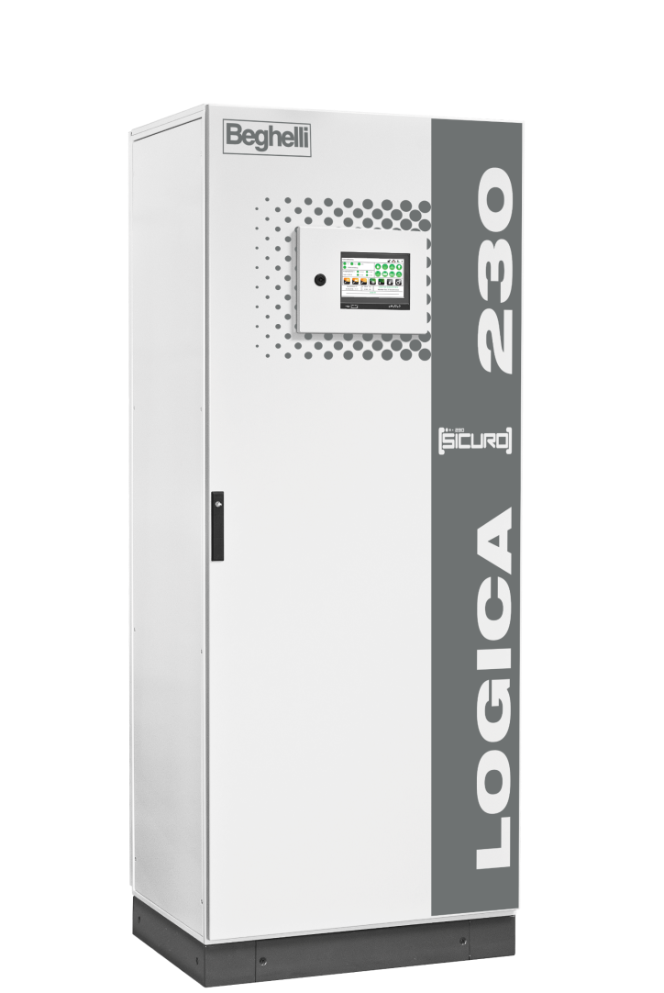

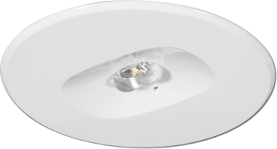
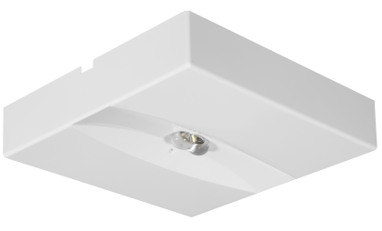
CENTRAL BATTERY EMERGENCY/ EXIT LIGHTING SYSTEMS
ELV PRODUCTS
25+ YEARS EXPERIENCE IN THE MARKET
EXISTING INSTALLATIONS IN DUBAI, ABU DHABI & SHARJAH
DCD APPROVED / AUTHORIZED AGENCY
EUROPEAN BRAND SPECIFIED WITH MAJOR CONSULTANTS.
DESIGN-SALES-TESTING & COMMISSIONING–MAINTENANCE.

Slide 4
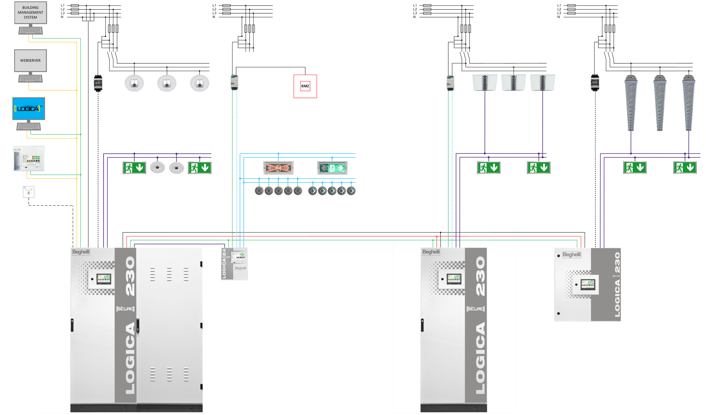
CENTRAL BATTERY EMERGENCY/ EXIT LIGHTING SYSTEMS
ELV PRODUCTS

Slide 5
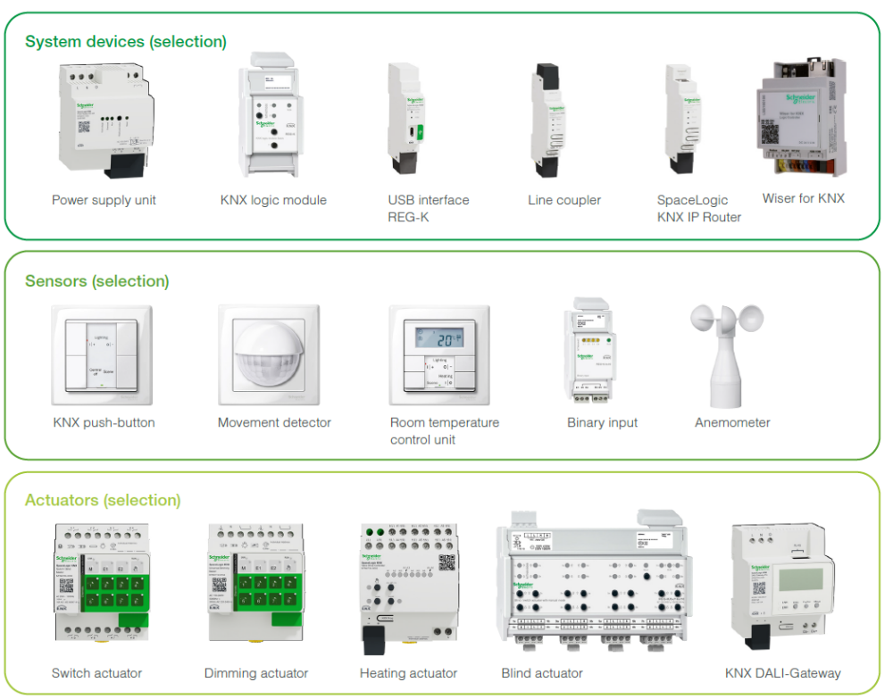
ELV PRODUCTS
LIGHTING CONTROL AND HOME AUTOMATION SYSTEMS
SCHNEIDER ECO-EXPERT CERTIFICATION.
MIX AND MATCH SOLUTIONS WITH PRODUCTS FROM DIFFERENT MANUFACTURES.
WIRED AND WIRELESS SOLUTIONS.
DESIGN-SALES-TESTING & COMMISSIONING–MAINTENANCE.

Slide 6
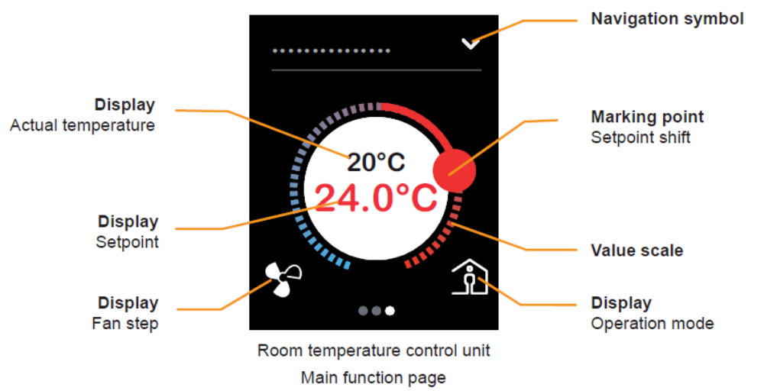
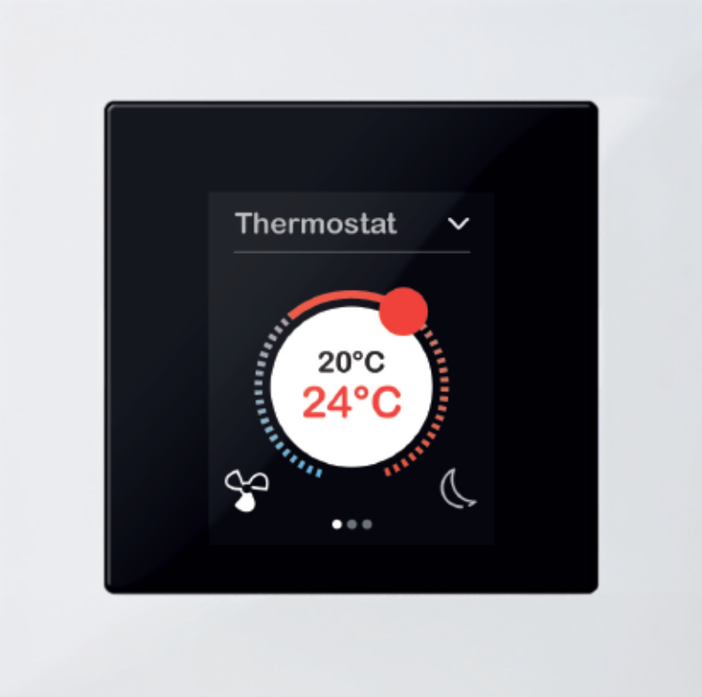
AC/HVAC CONTROL
ELV PRODUCTS

Slide 7
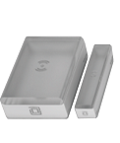
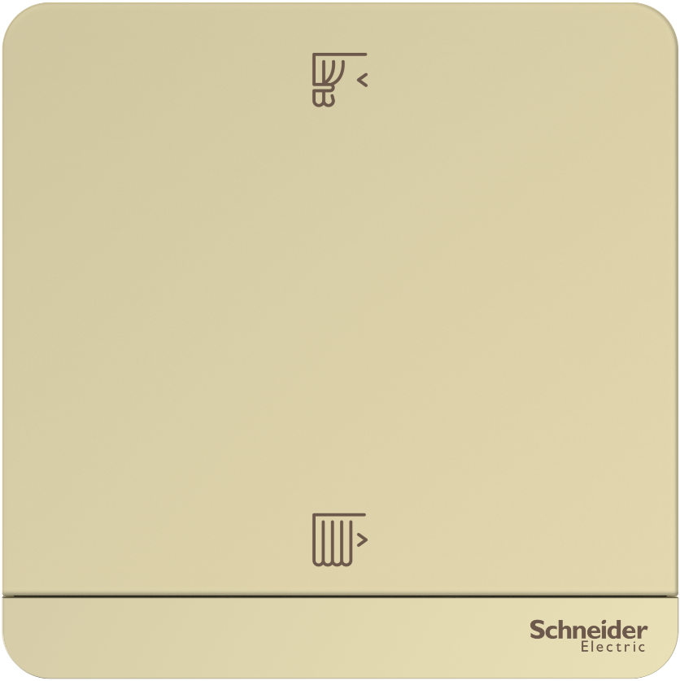
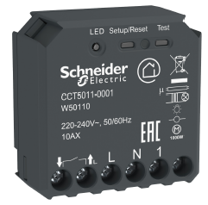
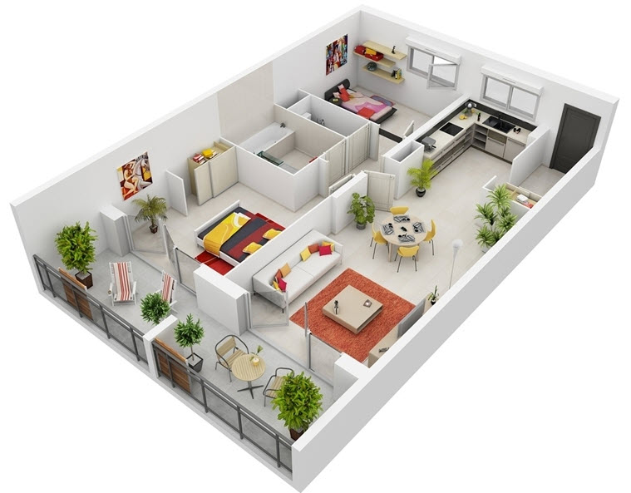
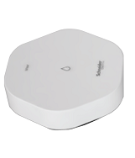
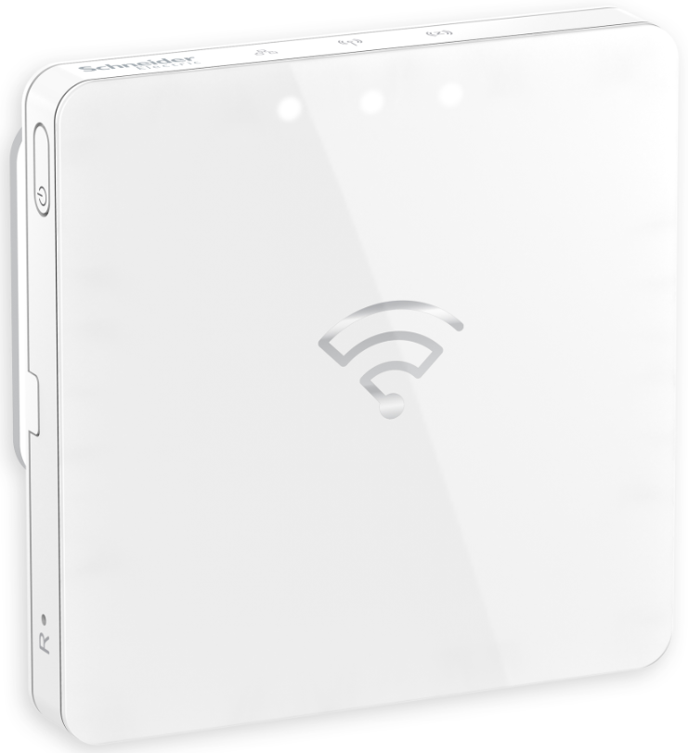
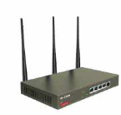
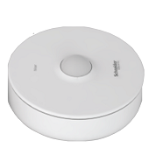
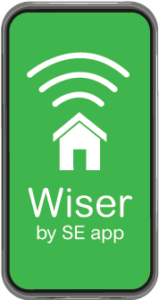
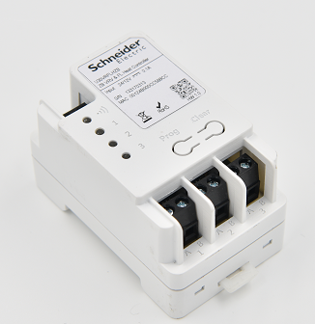
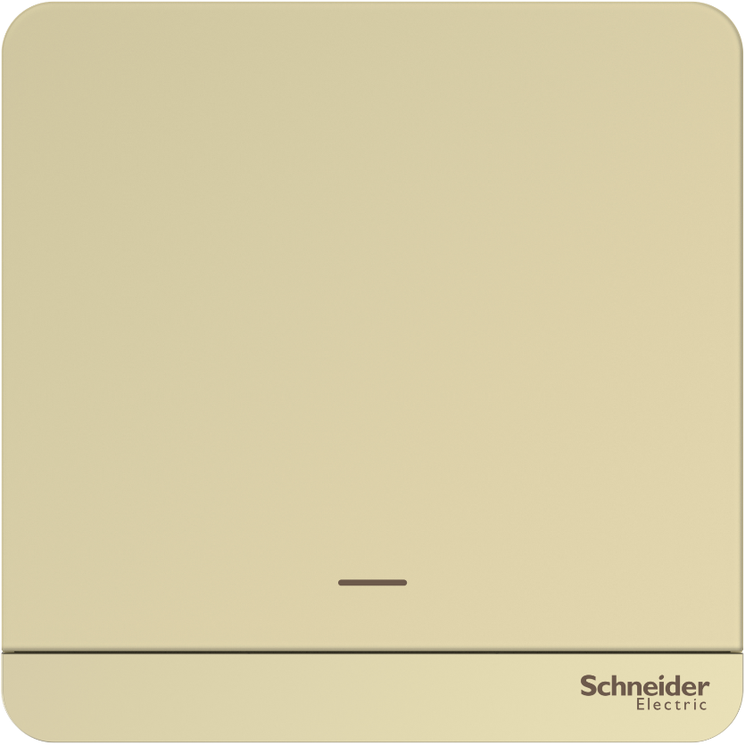
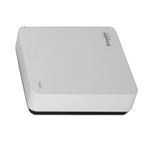
ELV PRODUCTS
LIGHTING CONTROL AND HOME AUTOMATION SYSTEMS
Wiser Smart Home
Multiple applications for connected homes
Wiser Puck
Wiser window and door sensor
Wiser shutter control
Wiser is a convenient, flexible system for control and monitoring the functions in your home.
Wiser offers you a wide range of solutions, which you can tailor according to your preferences and requirements.
One single Wiser app regardless of application.
Wiser is easy to install and easy to use.
Wiser water leakage sensor
Wiser IP gatewy
WiFi
Wiser motion sensor
Wiser Multifunction interface
Wiser lighring control
Wiser temperature and humidity sensor

Slide 8
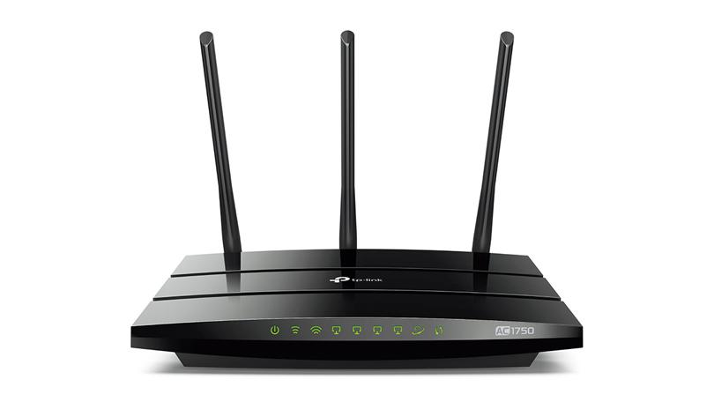

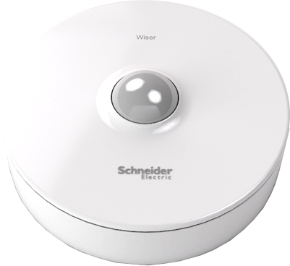

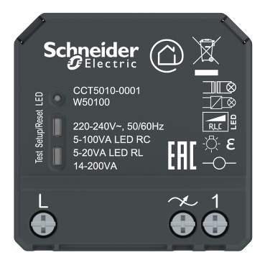

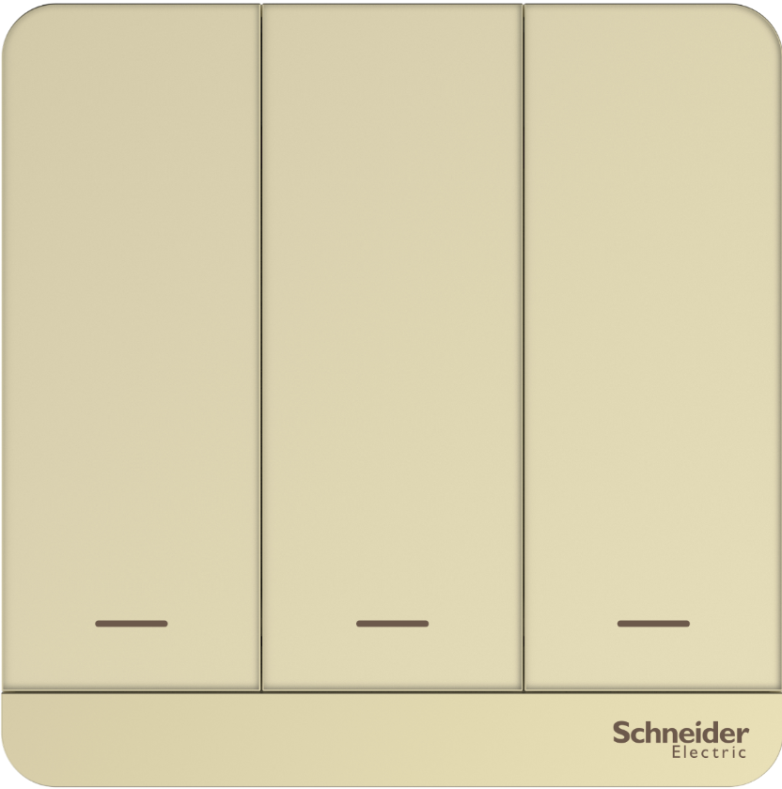
ELV PRODUCTS
LIGHTING CONTROL AND HOME AUTOMATION SYSTEMS
Operation with Wiser Gateway
4G
By using Wiser devices together with the Zigbee/IP gateway, you can control multiple functions in your smart house.
Via your own home network or from anywhere in the world via Port fordwarding and DDNS.
Control all the Wiser Smart Home devices with a single Wiser App and/or a Wiser Freelocate switch
Supported full range of Wiser devices such as :
  1/2/3G Switches
  1/2G Dimmer and Curtain Switches
  2/4 Keys free locate switches
  Water leakage, motion, temperature and Door contact sensor
  Multifunction gateway
  IP gateway
  360 degree IR converter
Cloud
DDNS service provider
TCP/IP

Slide 9
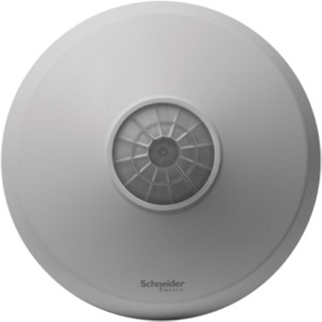
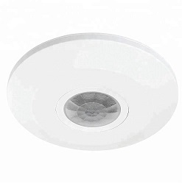
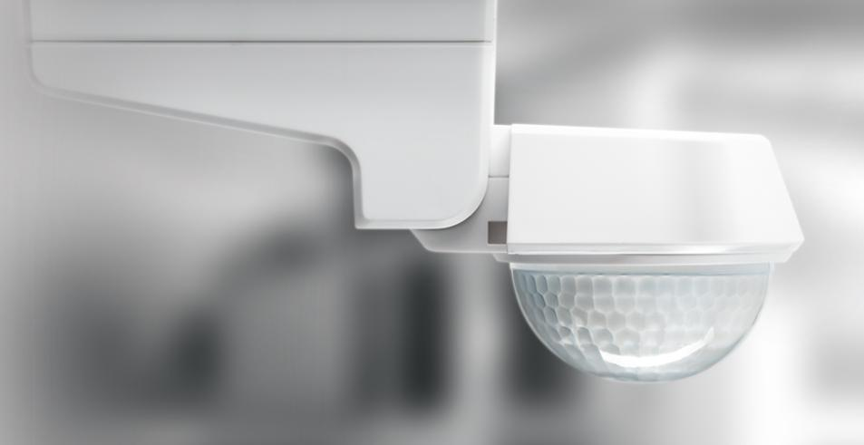
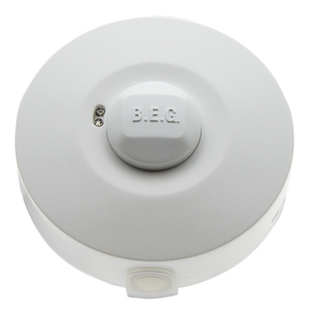
ELV PRODUCTS
STANDALONE MOTION DETECTORS
OFF THE SHELF PLUG AND PLAY ITEMS.
SENSORS FOR SPECIAL APPLICATIONS LIKE MEDICAL FACILITIES, PATIENT ROOMS, WAREHOUSES, HIGH BAY SENSORS.
CUSTOMIZED SOLUTION FOR PROJECTS.
AESTHETIC DESIGN AND WIDE RANGE.
Cloud

Slide 10
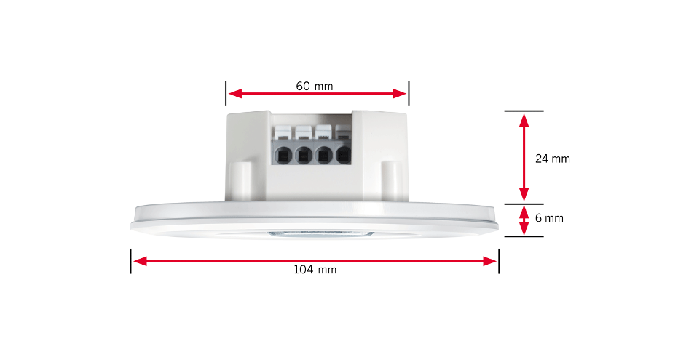
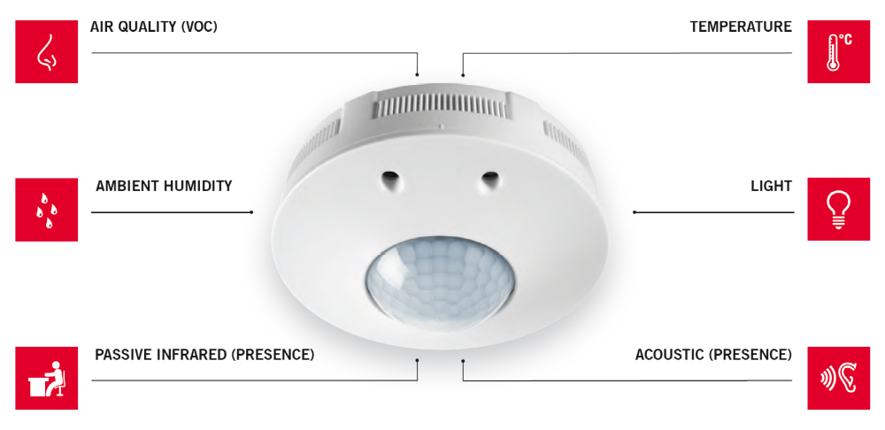
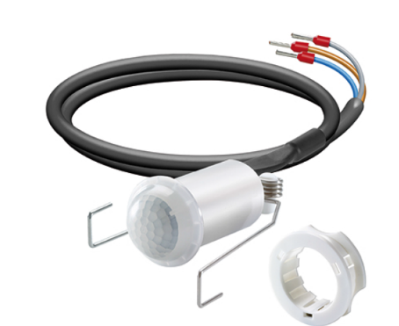
ELV PRODUCTS
STANDALONE MOTION DETECTORS
Cloud
FLAT DESIGN SENSOR- ESYLUX
SMART MULTIDISPLINARY CONTROL SENSOR-ESYLUX
MINI SENSOR-ESYLUX

Slide 11
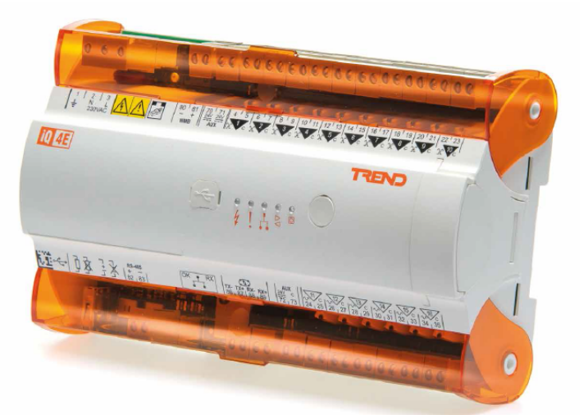
ELV PRODUCTS
BUILDING MANAGEMENT SYSTEM
COMPLETE SOLUTION WITH FIELD DEVICES, CONTROLLERS AND BMS SOFTWARE.
CUSTOMIZED SOLUTION FOR EXISTING BUILDINGS.
THIRD PARTY SYSTEMS INTEGRATION.
Cloud

Slide 12
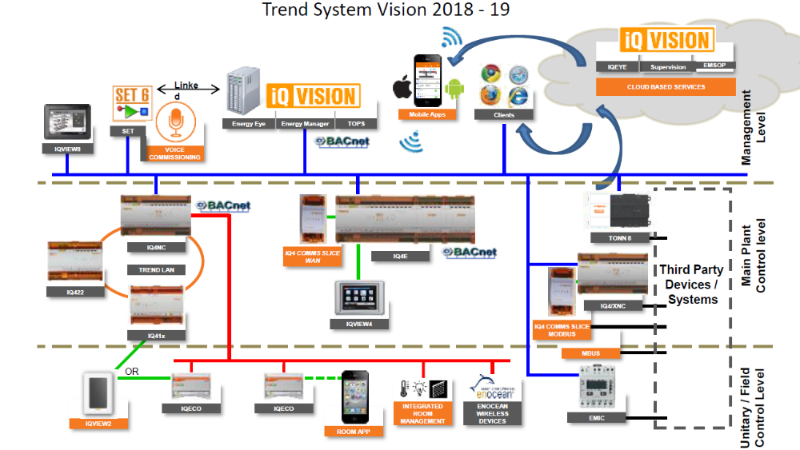
ELV PRODUCTS
BUILDING MANAGEMENT SYSTEM
Cloud

Slide 13
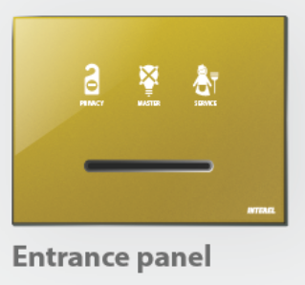
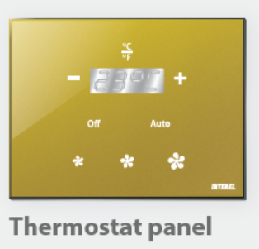
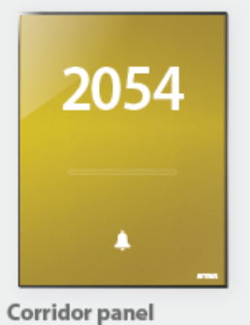
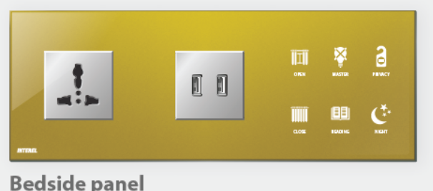
ELV PRODUCTS
GUEST ROOM MANAGEMENT SOLUTIONS
COMPLETE GUEST ROOM MANAGEMENT SOLUTION.
WIDE RANGE WITH CUSTOMIZED DESIGN AS PER PROJECT REQUIREMENTS.
CENTRALIZED/ STANDALONE OPTIONS.
Cloud

Slide 14
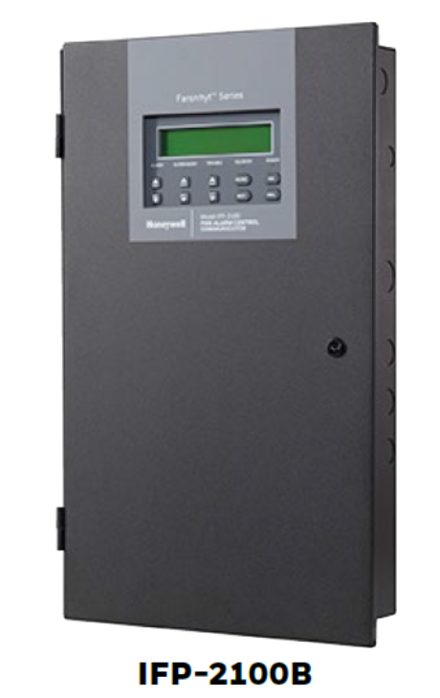
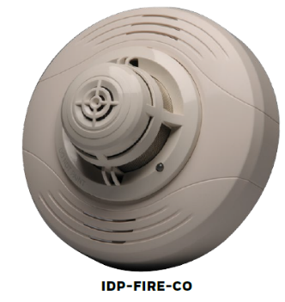
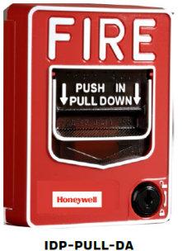
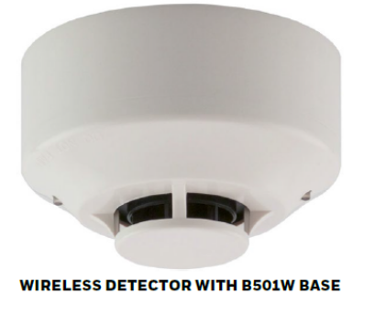
ELV PRODUCTS
FIRE ALARM SYSTEM
SCALABLE ANALOG/ADDRESSABLE FIRE ALARM SYSTEMS.
WIRED/WIRELESS DEVICES .
COMPLETE SOLUTION WITH DESIGN, SALES AND SERVICE.
Cloud

Slide 15
THANK YOU

